Slide 2

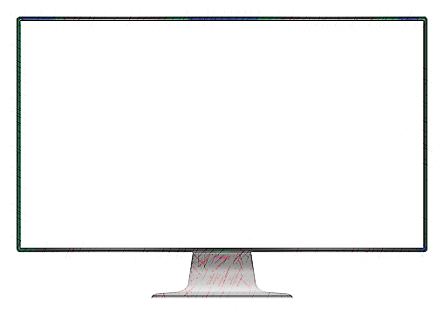
A Decentralised Censorship resistant social media on the Ethereum Blockchain.

